Slide 1
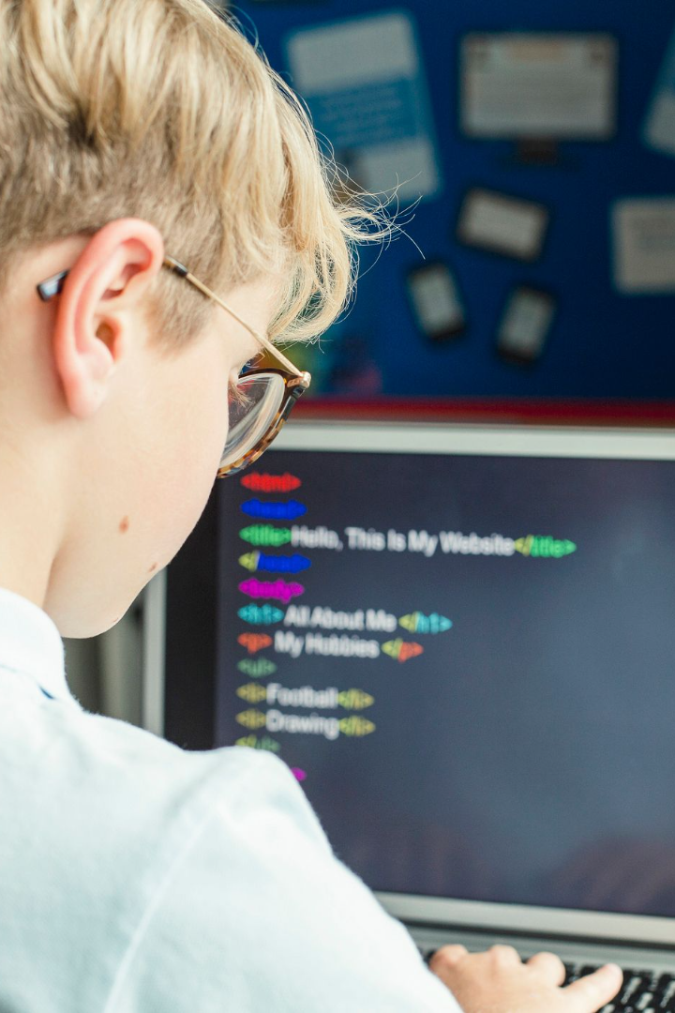
How to Become a Developer: A Guide for Kids
Welcome to this guide that will walk you through what skills and knowledge are essential to becoming a developer. With such a rapidly changing industry, it's critical to start learning early to be able to keep up with the pace.

Slide 2
Important Skills for Developers
Problem-solving
Critical Thinking
Attention to Detail
Developers must be able to solve complex problems and come up with creative solutions.
Developers should be able to think analytically and critically to ensure they are creating the most effective solutions.
Developers must be meticulous to ensure software is free from errors and works correctly.
Continual Learning
Developers must always be learning and improving their skills to stay up to date with new technologies and trends.

Slide 3
Python: An Introduction
If you are interested in an easy-to-learn and versatile programming language, then Python is the one for you! Python is perfect for beginners, it can be used for web development, data science, and machine learning. It's syntax is similar to English making it easy to read and write.
Easy to learn
Versatile
Community support
Simple, readable syntax
Applicable to many industries
Plenty of online resources

Slide 4

Python: What You Can Achieve
With Python, you can create several different projects. Here are some of the things you can achieve with Python:
Web Applications
Data Science Applications
Machine Learning Applications
Games
Desktop Applications

Slide 5

Java: An Introduction
Java is one of the most commonly used programming languages globally. Java is suitable for distributed systems and applications that process a large amount of data. It's used to generate and run the programs used in websites, mobile devices, and other applications.
1
Robust
2
Highly portable
Developed securely
Works efficiently across various platforms
3
Object-Oriented
Encapsulates real-world objects and behaviors

Slide 6
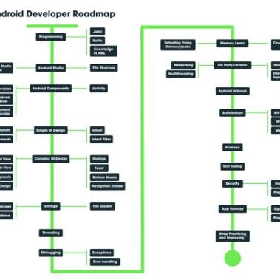

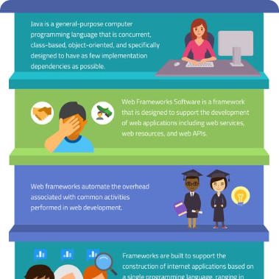
Java: What You Can Achieve
Once you become familiar with Java, you can create the following projects:
Mobile Applications
Games
Web Applications
Design and develop intuitive apps for smartphones
Develop your own games with fluid graphics and high-performance
Create professional and responsive websites

Slide 7
C++: An Introduction
If you are keen on creating programs that run efficiently and quickly, C++ is the way to go. It is considered one of the most powerful programming languages used for developing operating systems, computer graphics, and games.
Simpler Syntax
Efficiency
Compatibility
C++ builds on the original C language, meaning it has a smaller footprint than languages.
The use of pointers and memory management allows developers great control over their programs' execution.
Works on a wide range of platforms, from mobile phones to supercomputers.

Slide 8

C++: What You Can Achieve
C++ has been used for various projects such as:
Robotics
Operating Systems
Computer Games
Robots use C++ as the main language due to its fast, efficient, and robotic arm control capabilities.
It's the backbone of essential operating systems such as Windows, Mac OS, and Linux
The gaming industry uses C++ to build fast and efficient games with complex graphics.

Slide 9



Summary
Once you become familiar with Python, Java or C , you can work as the following developers:
Python
Java
C
Data scientist
Data analyst
Machine learning engineer
Game developer
Mobile app developer
Systems administrator
Device driver developer
Embedded systems engineer
Network engineer
Security engineer

Slide 10



Conclusion
Learning to code is an exciting and essential skill to help you create and innovate. Now that you have some knowledge about Python, Java, and C++, what are you waiting for? Start coding today, and who knows where it will lead you.

